Slide 1
LEARN. CONNECT. GROW.
It’s all in the details
The requirements of a successful notice.
Brett Waller

Slide 2
Brett Waller, NAAEI Faculty
General Counsel,
HNN Communities

Slide 3
Agenda
The law
Application of the law
Real world examples
Hypothetical examples

Slide 4
The Law says…
“All termination and non-renewal notices served upon residents must include a list of the specific violations constituting “good cause” so as to enable the tenant to prepare a defense.
Revenue Ruling 2004-82

Slide 5
The Law says…
All written notices required under subsection (2) of this section must identify the facts and circumstances known and available to the landlord at the time of the issuance of the notice that support the cause or causes with enough specificity so as to enable the tenant to respond and prepare a defense to any incidents alleged.
RCW 59.18.650(6)
Notes:
(b) The tenant continues in possession after substantial breach of a material program requirement of subsidized housing, material term subscribed to by the tenant within the lease or rental agreement, or a tenant obligation imposed by law, other than one for monetary damages, and after the landlord has served written notice specifying the acts or omissions constituting the breach and requiring, in the alternative, that the breach be remedied or the rental agreement will end, and the breach has not been adequately remedied by the date specified in the notice, which date must be at least 10 days after service of the notice;

Slide 6
How was school today?
Notes:
You have an unauthorized pet.
You failed to complete your paperwork.
There was an alteration outside your unit.
Let’s eat children
I like cooking my family and my pets.

Slide 7
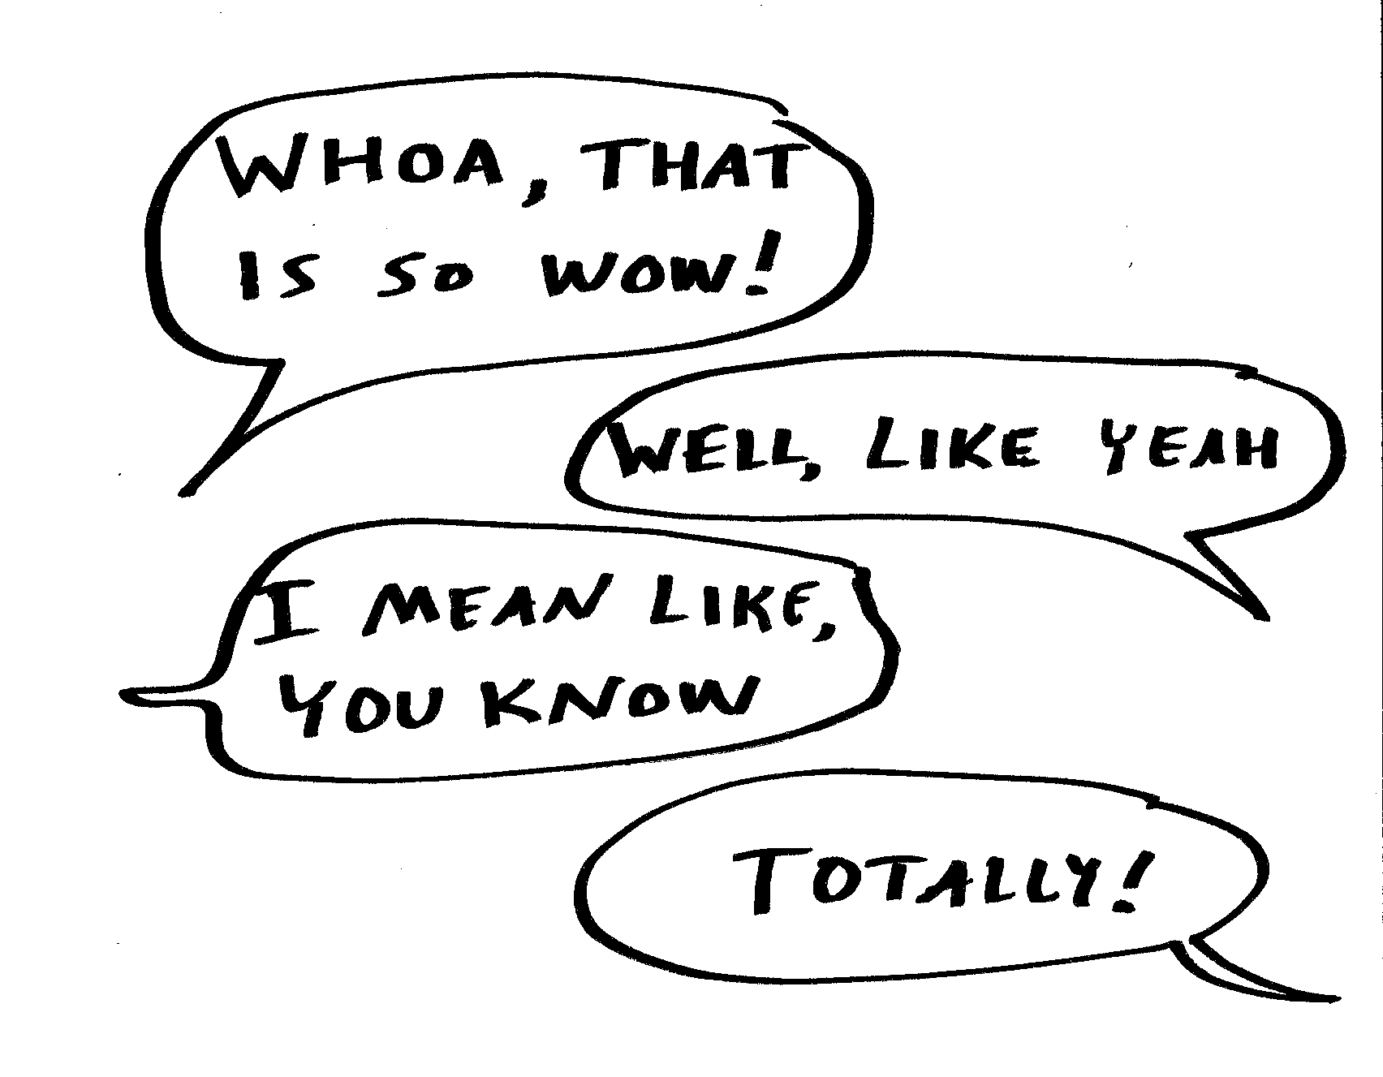
A vague notice is a void notice
Notes:
Do you ever feel like you have no idea what someone is talking about.

Slide 8
Behavior
Who
Where
When
What

Slide 9
Tow Court
Tenants and their guests shall not exhibit threatening, abusive, harassing,
intimidating, belligerent, or annoying conduct toward Landlord, Landlord’s site staff, agent, vendors or other authorized representatives.
Notes:
This changes things a little bit doesn’t it.

Slide 10
Tow Court
Tenants and their guests shall not exhibit threatening, abusive, harassing,
intimidating, belligerent, or annoying conduct toward Landlord, Landlord’s site staff, agent, vendors or other authorized representatives.
Notes:
This changes things a little bit doesn’t it.

Slide 11
"It's the little details that are vital. Little things make big things happen."
Notes:
Is the jar full? Can we add any more items to it?

Slide 12
Unauthorized…
“There are unauthorized occupants in the unit.”
Notes:
What makes a person an unauthorized occupant?

Slide 13
Unauthorized…
“It was reported that you have a dog.”
Notes:
How do you know they have a dog?

Slide 14
Take out the trash
All trash and garbage must be tied in plastic bags and placed inside the dumpster or trash compactor closest to the Tenant’s unit. Do not leave trash outside any door, in the hallway or on the patio/ balcony.
Notes:
How many of you have residents that leave trash next to someone else’s door?
How do we know that all of this garbage is the tenants?

Slide 15
Opportunities to Improve your Notice
Witness Statements
Professional testing
Security video footage
Court records
Photographs
Police Reports
Notes:
(b) The tenant continues in possession after substantial breach of a material program requirement of subsidized housing, material term subscribed to by the tenant within the lease or rental agreement, or a tenant obligation imposed by law, other than one for monetary damages, and after the landlord has served written notice specifying the acts or omissions constituting the breach and requiring, in the alternative, that the breach be remedied or the rental agreement will end, and the breach has not been adequately remedied by the date specified in the notice, which date must be at least 10 days after service of the notice;

Slide 16
Do’s and Don’ts of Notice Language
At 8:30 AM, on April 25, 2023, you provided a presentation about noticing …
A. Smith reported to us on April 25, 2023 …
Tax credit law requires you provide evidence of all income sources, including pay stubs, bank statements, tax returns, etc.
Your guest T. Brady was arrested on-site on April 24, 2023 at 12:35 AM. The police report identifies his address …
It’s all in the details
I heard you did a presentation about stuff.
Someone reported to us …
You failed to provide recertification documents.
You have an unauthorized guest

Slide 17
LEARN. CONNECT. GROW.
I like to cook my family and my pet.
Let’s Eat, Children!

Slide 18
LET'S STAY IN TOUCH
I would love to connect!
Email
Brett.waller@hnnwa.com
LinkedIn
@cbrettwaller

Slide 19
LEARN. CONNECT. GROW.
THANK
YOU

