Slide 1


Special Claims:
Simplified
A brief discussion of timeframes, the regular vacancy checklist, and helpful tips.

Slide 2
Presenter Information:
Name: Lori Mannerude
Title: PBCA Voucher Manager
Email: lmannerude@cms-results.com
Phone: 360-616-7250
Special Claims - Simplified

Slide 3




Training Agenda:
Timeframes
Checklist Review (Regular Vacancy Claims)
Quiz
Helpful Tips
Special Claims - Simplified
Notes:
Today we will be reviewing the following: Timeframes in regards to special claims, such as submission deadlines, CA review deadlines, and when the claim needs to be requested on a voucher. For the majority of this presentation we will be discussing the claim packet for Regular Vacancy claims. We will utilize the CMS checklist and review each item, to hopefully give you a fairly good idea of what needs to be included with the claim packet. We will briefly review TRACS, specifically two reports (the Tenant Certification Query and the Move In/Move Out Query) which are utilized when processing special claims. Finally, we will take a short quiz to test what we’ve learned. I will pause between each training item to allow for any questions you might have.

Slide 4
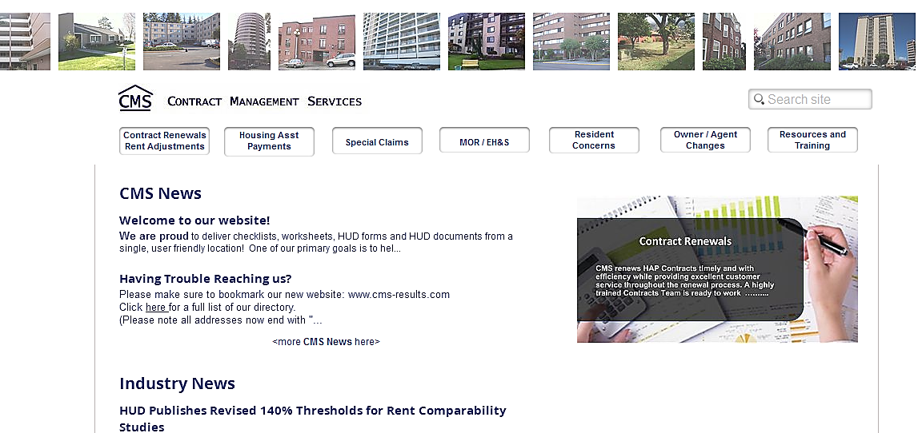
CMS Website: www.cms-results.com
Current HUD Forms
Processing Guide & FAQs
Special Claims Checklist
Special Claims - Simplified
Notes:
As a reminder, our website contains valuable tools to assist owner/agents by providing checklists, worksheets, helpful website links, HUD forms/documents, and industry news. You can obtain a copy of the checklist used in this training by visiting our website and clicking the Special Claims tab, and selecting CMS Checklists.

Slide 5


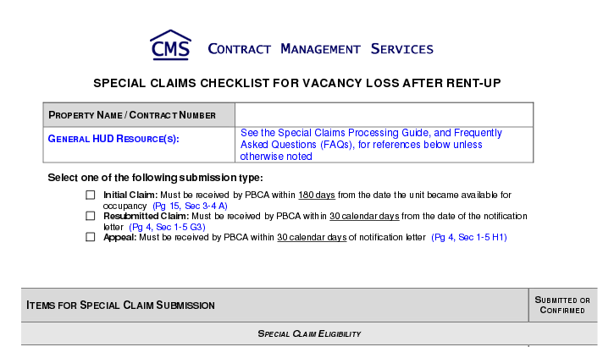
Timeframes
Special Claims - Simplified
Notes:
Let’s begin by discussing the timeframes and deadlines for claims (this information is listed at the top of the CMS checklist for easy referencing).

Slide 6
Timeframes: 180 Days:
Claim must be received by CA within 180 days from the date unit is available for occupancy.
  Reminder: The date the unit is ready for occupancy is the day AFTER all work was completed in the unit.
Special Claims - Simplified
Notes:
A completed claim form and documentation must be received by HUD or the CA within 180 days from the date the unit is available for occupancy. Be sure to review the Vacancy Reconditioning Log (s) included with the claim to ensure that the date is listed correctly as the day AFTER all work was completed in the unit (during our reviews, we often find that O/As use the last day work was done in the unit, which is incorrect). Adjusting the unit ready for occupancy date, even by one day, can sometimes mean the difference between a valid, or invalid claim. If it took over 30 days to complete work on the unit, it is helpful to include notes on the reconditioning log to let reviews know the reason for the lengthy turnover.

Slide 7
Timeframes: CA Review – 30 Days:
CA has 30 days to process/return.
  Email claims to:
    Vouchers@cms-results.com
  Mail claims to:
    Contract Management Services
    345 6th Street, Suite 200
    Bremerton, WA 98337-1860
Special Claims - Simplified
Notes:
Once CMS receives a special claim, we have 30 days to process and return the forms to the owner. Claims can be submitted electronically and no longer require wet signatures. Please email completed claims to our CA Vouchers inbox, which is Vouchers@cms-results.com. Or you can mail claim packets to Contract Management Services 345 6th Street, Suite 200, Bremerton WA 98337-1860. CA reviewers will typically contact you to request clarification or corrections before making the final decision on the claim.

Slide 8

Timeframes: Resubmissions & Appeals:
Resubmissions/Appeals must be received within 30 days from the letter date.
Original Submission
Resubmission
Appeal
Special Claims - Simplified
Notes:
If the claim is denied, the owner must resubmit/appeal the claim package within 30 calendar days from the date of the letter included with the returned claim package. Any resubmissions/appeals received after the 30 days will be denied and ineligible for resubmission. Keep in mind that the owner/agent is allowed one original submission, one resubmission, and one appeal.

Slide 9
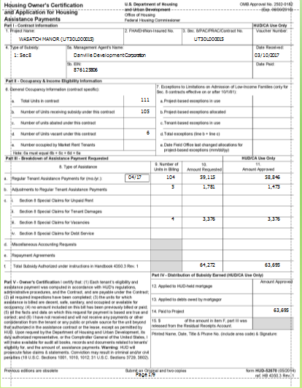
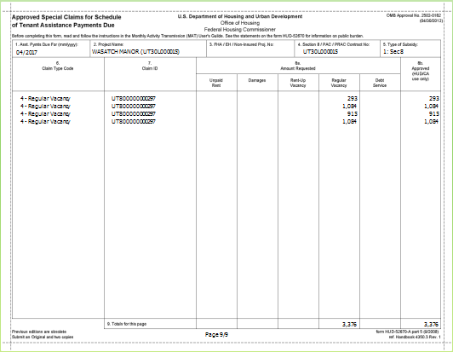
Timeframes: Request on Voucher:
Must request payment on voucher within 90 days from approval date.
Special Claims - Simplified
Notes:
The owner/agent should request payment for an approved claim on the next schedule voucher. However, payment must be requested within 90 calendar days from the date of the approval decision or. If the request is not submitted within 90 days, the claim will be ineligible for payment.

Slide 10

Questions?
Special Claims - Simplified
Notes:
Are there any questions so far?

Slide 11

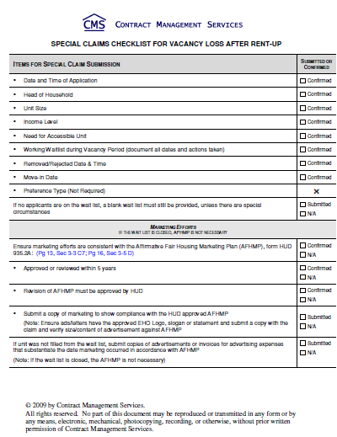
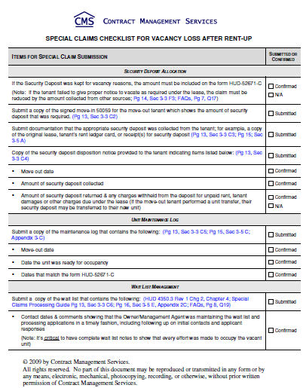
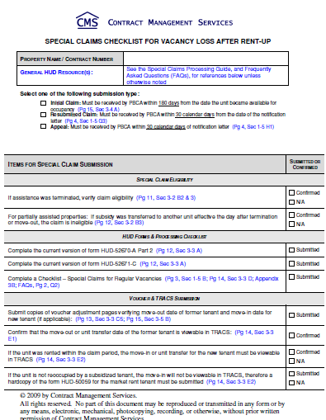
Checklist Review
Special Claims - Simplified
Notes:
Next, we’ll take a look at each item on the CMS Special Claims Checklist for Regular Vacancies and briefly review the requirements. Keep in mind, CMS allows O/As to create and submit their own checklists – these can include the sample checklists contained in the Special Claims Guide.

Slide 12
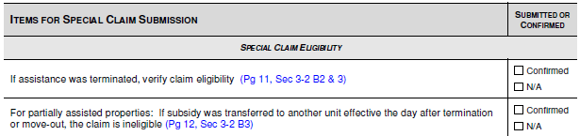
Checklist Review: Special Claim Eligibility
Tenant Terminated: Cannot be due to being over- income.
Subsidy Slots: Cannot be moved to another unit the day after the TM/MO.
Special Claims - Simplified
Notes:
The first section on the checklist reminds the O/A to ensure the claim is valid and that the tenant was not terminated due to being over income (other Termination reasons are acceptable). Additionally, O/As cannot submit a claim for a unit that was occupied by security personnel/police officers.
For properties that are partially subsidized, if a subsidy slot was given to another tenant in a different unit the day after the termination or move-out, a claim cannot be requested.

Slide 13
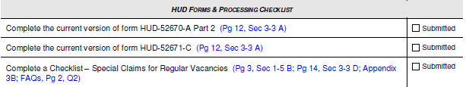
Checklist Review: HUD Forms & Processing Checklist
HUD 52670-A Part 2 “Schedule of Special Claims”: MUST have signature, printed O/A name, date, & phone #.
HUD 52671-C “Calculation Sheet for Vacancies Claims”: MUST have signature, printed O/A name, and date.
Special Claims - Simplified
Notes:
So what paperwork needs to be submitted with a claim?
The HUD 52670-A Part 2 “Schedule of Special Claims” is the first document listed on the checklist. On this form, O/As will want to list all claims being submitted (can submit claims of different types together but all must appear on this schedule with the amount requested listed in the appropriate box for the unit under claim type; can also submit multiple claims of the same type together). This form must have signature, printed name of owner/management agent, date and phone number in the bottom left box of the form.
Additionally, the HUD 52671-C “Calculation Sheet for Vacancies Claims” must be included with the claim (one per each unit being requested). This form includes important information such as the unit ready for occupancy date, the contract rent at move-out, and any amount paid by other sources. It must have signature, printed name of owner/management agent, and date in the bottom left box of the form. Remember, the maximum amount of time that HUD will compensate a property for a vacancy loss is 60 days from the unit ready date if no move-in has occurred. If the unit is still vacant and 60 days have not passed, do NOT submit the claim. Line 11 on this form, “Amounts paid by other sources” is utilized if other funds were used to cover the vacancy loss, such a when a tenant fails to give 30 day notice and the property keeps the security deposit.

Slide 14

Checklist Review: Voucher & TRACS Submission
Voucher Adjustments: Submit adjustment pages showing:
  Prior Tenant: MO, UT, or TM.
  Incoming Tenant: MI, IC, or UT.
Special Claims - Simplified
Notes:
The first item on under the Voucher & TRACS Submission, the next section of the checklist, is to submit copies of voucher adjustment pages verifying the move=out date of the former tenant and the move-in date for the new tenant (if applicable). Simply submit a copy of the adjustment page(s) from the vouchers where the move-out, unit transfer, or termination for the prior tenant appeared, as well as a copy of the page(s) showing the adjustments for the move-in, initial, or unit transfer for the incoming tenant. The CA will then review these adjustments to ensure the correct HAP was paid.

Slide 15
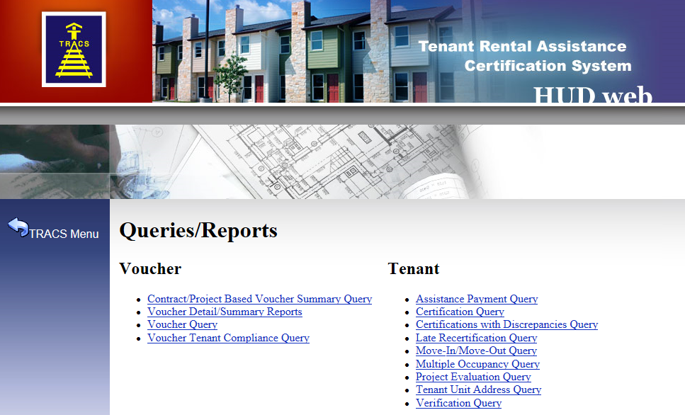
TRACS (Tenant Rental Assistance Certification System):
Special Claims - Simplified
Notes:
The next item under Voucher & TRACS Submission on the checklist deals with reports that are obtained via TRACS. Before we get into this section, as a refresher, TRACS (which stands for Tenant Rental Assistance Certification System), is a HUD computer system which collects tenant and voucher data. This data undergoes rigorous automated reviews to ensure accuracy and compliance with HUD regulations. The two reports we will be reviewing are the Certification Query and the Move-In/Move-Out Query (circled in red above).

Slide 16
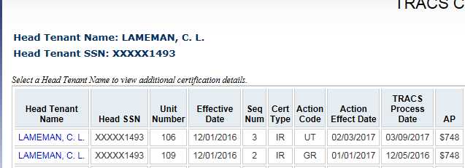
Checklist Review: Voucher & TRACS Submission
Certification Query: Used to show unit transfers.
Special Claims - Simplified
Notes:
The TRACS Certification Query lists the tenant data for the property. This query displays the most current active household certification within the past 15 months. When it comes to special claims, this report is utilized for showing Unit Transfer dates, since these do not show up on the Move In/Move Out Query.

Slide 17
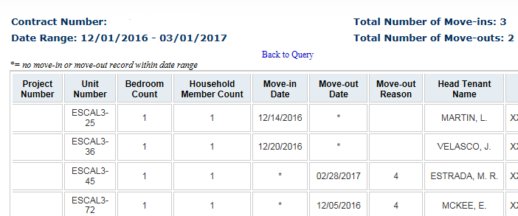
Checklist Review: Voucher & TRACS Submission
Move-In/Move-Out Query: Displays MIs and MOs for set date range.
Special Claims - Simplified
Notes:
The next report, the Move-In/Move-Out Query is self-explanatory – users can select a date range and view the total number of move ins and move outs for the property during the specified time period. In addition to listing the effective dates of these certifications, it also includes a code to show the move out reason, such as code ‘4’ for a deceased tenant, etc. Remember, per the Claims Guide, it is required that the move-outs, move-ins, and unit transfers be visible in TRACS when the claim is submitted. These two reports provide O/As with an easy way to confirm that the correct certifications are in TRACS.

Slide 18
Checklist Review: Voucher & TRACS Submission
Market Rent Tenant: Submit the 50059 for the market rent tenant.
Special Claims - Simplified
Notes:
The final item under Voucher & TRACS Submission deals with market rent tenants. If the new move-in is a market rate tenant, a signed HUD 50059 move-in for that tenant must be submitted with the claim.

Slide 19
Questions?
Special Claims - Simplified
Notes:
Are there any questions so far?

Slide 20
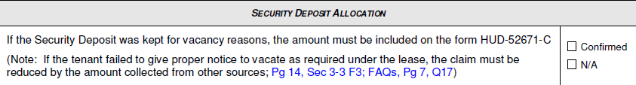
Checklist Review: Security Deposit Allocation
Line 11: Reduce Claim If:
  Security deposit kept for improper notice.
  Incorrect security deposit collected at move-in.
  Rent charged beyond move out for improper notice.
Special Claims - Simplified
Notes:
Lets discuss page 2 of the checklist, which starts with security deposit allocation. The checklist states that if the security deposit was kept for vacancy reasons, such as the tenant failing to give proper notice to vacate, then the claim needs to be reduced by the amount(s) collected from other sources. Additional items that would be included are if the owner/agent collected the incorrect amount of security deposit at move in, and also if the owner/agent charged rent beyond the move out date. These amounts must be entered into line 11 of the 52671 form.

Slide 21
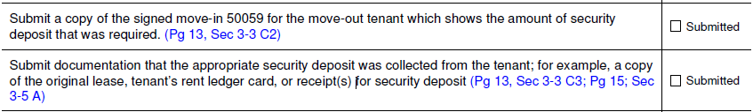
Checklist Review: Security Deposit Allocation
Verify Security Deposit:
  Submit SIGNED move-in 50059 showing security deposit.
  Submit proof of security deposit collected.
Special Claims - Simplified
Notes:
The next two items on the checklist go hand-in-hand. The first requirement is to submit a copy of the signed move-in 50059 for the tenant who moved out of the unit, which shows the security deposit collected (so please include page 2 of the 50059). Also, owner/agents must submit proof that the tenant paid the security deposit required per the move-in 50059. This can be a copy of the initial lease (please include the signature pages), a ledger showing the deposit collected, or simply a receipt.

Slide 22
Checklist Review: Security Deposit Allocation
Security Deposit Disposition:
  Move-out date;
  Security deposit collected plus interest;
  Amount returned and any charges withheld.
Special Claims - Simplified
Notes:
Next is the Security Deposit Disposition. This form can be owner/agent created but must include the move-out date, amount of deposit collected with any interest, amount of deposit returned and any charges withheld from the deposit (unpaid rent, damages, or other charges allowed under the lease). This is required documentation for a vacancy claim even if the entire deposit was returned. If the initial deposit was transferred over to a new unit (on a unit transfer), provide a copy of the ledger to substantiate.

Slide 23

Sample Security Deposit Disposition:
Special Claims - Simplified
Notes:
Note the highlighted items on this sample Security Deposit Disposition Notice – specifically the move-out, the security deposit collected (ensure this amount matches all other documentation submitted with the claim), interest on the security deposit, and any charges against the security deposit. For prorated charges, such as rent, it is helpful to indicate the timeframe for the charges so that the reviewer has a breakdown to match the calculations.

Slide 24
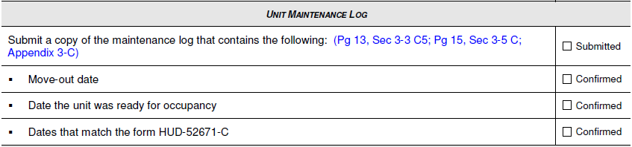
Checklist Review: Unit Maintenance Log
Maintenance Log:
  Move-Out date;
  Ready for occupancy date;
  Ensure dates match HUD-52671.
Special Claims - Simplified
Notes:
The next requirement on the checklist is a unit maintenance log. We will review a sample pulled from the special claims guide on the following screen; however, if the property maintains their own maintenance log that shows the move-out date and dates when work to prepare the unit for occupancy are recorded, this is considered acceptable – owner/agents are not required to use the sample provided in the claims guide book.

Slide 25
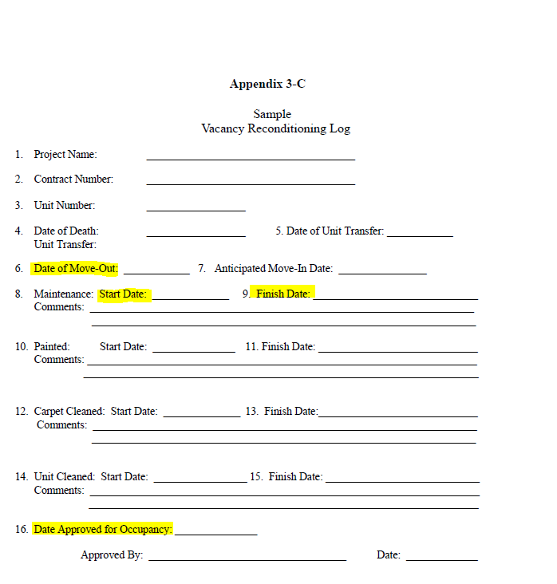
Checklist Review: Unit Maintenance Log
Ensure dates match HUD-52671!
Special Claims - Simplified
Notes:
This is a sample Vacancy Reconditioning Log pulled from the Special Claims Processing Guide. The most important items to include on the reconditioning log are highlighted above – the move out date, start and finish date for work completed, and the date approved for occupancy (ensure this date matches the HUD-52671).

Slide 26
Questions?
Special Claims - Simplified
Notes:
Are there any questions so far?

Slide 27
Checklist Review: Wait List Management
The Wait List: Must include:
  Date & time of application;
  Head of household;
  Unit size;
  Income level;
  Need for accessible unit;
  Removed/rejected date & time;
  Move-in date;
  Preferences (if applicable).
Special Claims - Simplified
Notes:
When it comes to wait list management, the HUD handbook is very clear about what items MUST be included on the wait list. These items are:
Date/time of application,
Head of Household,
Unit Size,
Income Level (L, VL, EL),
Need for Accessible Unit,
Remove/Rejected Date and Time,
Move-In Date, and
Preferences if applicable.
The reviewer will be looking for comments that demonstrate the property was working the list in a timely fashion to fill the vacancy, as well as following the correct order of applicants on the waiting list. Per the FAQs number19: “The waiting list should be properly documented to indicate that applicants are contacted in a timely manner, regardless of when the applicant was placed on the waiting list. This is something that HUD or the CA should review as part of the special claims process as well as during an MOR.”

Slide 28

Checklist Review: Wait List Management
The Wait List: Tips:
  Include several pages prior to and after move-in tenant;
  Make sure comments verify order & timeliness;
  Print wait list in application order.
Special Claims - Simplified
Notes:
Prior to submitting the claim, make sure the following items are available for the review:
1. The review must look at the “past several months and the outcome of applicant contacts” per the
Claims Guide Section 3-5 E pg 16 so make sure the lists contains not only the applicant(s) who moved
into or were contacted about the unit(s) the claim is on but several pages prior to that as well.
2. Make sure the comments contained under each applicant allow the reviewer to verify order and
timeliness.
3. Make sure the waiting list is printed in application order (this is particularly important for properties
exporting the list from their system because of all of the export options available).
For unit transfers requests, some properties add them to their regular waiting list and others maintain a
separate unit transfer list. If a separate list is kept, please include the unit transfer list in the claims
packet if some/all of the units are being filled by these applicants.

Slide 29
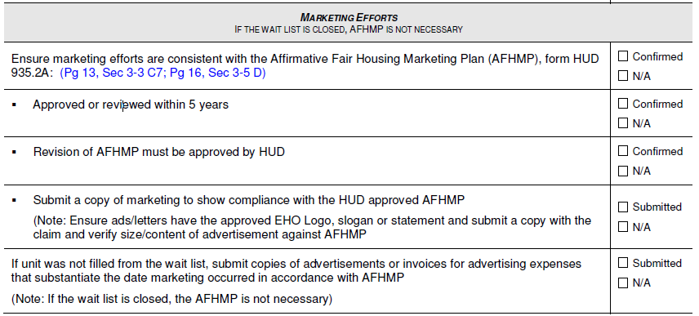
Checklist Review: Marketing Efforts
AFHMP Requirements: Marketing and updating
Special Claims - Simplified
Notes:
The last section of the checklist deals with marketing efforts. The claims guide states that if a vacancy has not been filled within 60 days, advertising in accordance with the property’s AFHMP will need to be submitted. FAQ 19 further clarifies by stating, “If there is an excessive length of time between the time the last person was placed on the waiting list before the unit was vacated, and the date the selected applicant was placed on the waiting list, advertising documentation should be submitted.”
If in doubt, it is best to simply submit the AFHMP and applicable advertising with the claim packet.
Owner/agents are required to provide a copy of the most recently approved AFHMP (Affirmative Fair Marketing Housing Plan) HUD-935.2A. If it has an approval date of over 5 years include either the documentation that it was reviewed and it was found no changes are required or a note that a new one has been submitted for approval (or the property is currently working on a new plan). Also, owner/agents will need to provide documentation of advertisements or copies of invoices covering the vacancy period of the claim.

Slide 30
Questions?
Special Claims - Simplified
Notes:
Are there any questions so far?

Slide 31


Quiz
Special Claims - Simplified
Notes:
Finally, let’s take a quick quiz. The quiz will be true or false, so simply raise your hand or shout out the correct answer.

Slide 32

Quiz: Test your knowledge…
A tenant fails to give proper notice prior to moving out. I can keep the security deposit and do not need to include it on the HUD-52671 form:
  True?
  False?
Special Claims - Simplified
Notes:
False – if the security deposit is retained for failure to give notice to vacate, it must be included on line 11 of the 52671.

Slide 33
Quiz: Test your knowledge…
A claim is received by the PBCA within 181 days from the date the unit became available for occupancy. It is still acceptable since it was mailed out prior to 180 days:
  True?
  False?
Special Claims - Simplified
Notes:
False - (The PBCA must “receive” a claim within 180 days, no later, or it will be denied.)

Slide 34
Quiz: Test your knowledge…
One of the HUD required items on the waiting list is the date AND time of removal:
  True?
  False?
Special Claims - Simplified
Notes:
True – ensure the time is noted, not just the date of removal.

Slide 35
Quiz: Test your knowledge…
A tenant moved out of a unit leaving it extremely clean and ready for occupancy immediately. Another tenant moved in the following day. A vacancy claim can be filed claiming the one day:
  True?
  False?
Special Claims - Simplified
Notes:
False - (This would be an invalid claim as there were no vacant days to claim.)

Slide 36
Quiz: Test your knowledge…
After reviewing the documentation it was determined that only part of the security deposit was collected from the tenant. This special claim would therefore be denied:
  True?
  False?
Special Claims - Simplified
Notes:
False - (The claim would be reduced by the amount of the security deposit that the O/A did not collect.)

Slide 37
Quiz: Test your knowledge…
A ledger is sufficient to prove the security deposit collected at move-in:
  True?
  False?
Special Claims - Simplified
Notes:
True – a signed MI lease or receipt.

Slide 38
Quiz: Test your knowledge…
The property must request payment on a voucher within 90 days of the approval letter:
  True?
  False?
Special Claims - Simplified
Notes:
True.

Slide 39
Quiz: Test your knowledge…
On my waitlist, I only need to document dates that units were offered to applicants, move-in dates, and rejected dates:
  True?
  False?
Special Claims - Simplified
Notes:
False - (Document all actions taken. The waitlist needs to indicate that applicants are contacted timely and in the proper order.)

Slide 40


Helpful Tips
Special Claims - Simplified
Notes:
To wrap things up, lets go over a few helpful tips related to issues we often encounter as the CA.

Slide 41

Helpful Tips: TRACSmail ID
Why is it important to have the correct TRACSmail ID?
  Ensures messages are transmitted to CA
  Ensures TRACS messages are received from CA
  Ensures final approved voucher is sent back to property
Special Claims - Simplified
Notes:
TRACSmail ID
Verify software is sending to the correct TRACSmail ID. Including both the sender (your) TRACSmail ID and receiver’s (CA) TRACSmail ID.
Why is this important?
Will ensure messages are transmitted to CA.
Will ensure messages from TRACS are transmitted back to you.
Will transmit the final approved voucher back to you.

Slide 42
Helpful Tips: TRACS Queries
Certification Query
Displays the most current active household certification within the past 15 months.
Allows Owners and CA ability to review the certification history for a household in the project.
Certification History List
Report contains information for Owner or CA on certifications containing discrepancies and gives information for corrections.
Certification Discrepancies Report
Query lists households within your project that are late in recertifying.
Late Recertification Report
Move-In/Move-Out Query
Provides a list of all move-ins and move-outs for a specific property
Allows for Owners and CA the ability to retrieve detailed information regarding vouchers that have been submitted for payment.
Voucher Query
Notes:
Review queries - be proactive!

Slide 43


Helpful Tips: Sending Appropriate Certifications
    Incorrect: Transmission of a $0 HAP Annual.
    Correct: Transmit a Termination of subsidy.
Special Claims - Simplified
** No need to send $0 HAP Gross Rent files
Notes:
As the CA, we occasionally see owner/agents submitting Annuals requesting $0 HAP. This is incorrect - if the tenant’s income increases to the point where they no longer qualify for subsidy, a Termination should be processed, effective on the last day of the applicable month. We also see $0 HAP Gross Rent files – it is not necessary to send these files.

Slide 44
Helpful Tips: Sending Appropriate Certifications
    Annual Certification – Required annually corresponding to month of move-in, unless otherwise approved by HUD.
    Interim Certification - Reporting changes of income or family composition during the year.
    Initial Certification - Establish subsidy for a tenant that was ineligible at move-in, or previously terminated.
Special Claims - Simplified
Notes:
Annual Certification – required annually corresponding to month of move in, unless otherwise approved by HUD.
Interim Certification- reporting changes of income or family composition during the year.
Initial Certification- establish subsidy for a tenant that was ineligible at move in, or previously terminated.

Slide 45

Ensuring Timely Payment: What you can do…
    Revised Voucher (MAT 30) – When transmitting revised tenant files also transmit a revised voucher:
        Ensures monthly HAP payment, adjustments, and voucher are correct.
        Owner/agent software will reflect the same data as the CA.
        No discrepancy notifications – MOR finding.
Special Claims - Simplified
Notes:
Tips to ensure a timely payment
When transmitting revised tenant certifications also transmit a revised Voucher (MAT 30).
Why is this important?
Doing so will ensure the monthly HAP payment, adjustments, and Voucher (MAT 30) are correct. O/A software will reflect the same data as CA software and TRACS. No discrepancy notifications – MOR finding.

Slide 46
Helpful Links: Stay informed!
    TRACS HUD Homepage:
      http://portal.hud.gov/hudportal/HUD?src=/program_offices/housing/mfh/trx/trxsum
    202D MAT Guide / Specifications:
      http://portal.hud.gov/hudportal/HUD?src=/program_offices/housing/mfh/trx/trxdocs
    TRACS Announcements:
      http://portal.hud.gov/hudportal/HUD?src=/program_offices/housing/mfh/trx/trxsum
Special Claims - Simplified
Notes:
TRACS HUD Homepage: http://portal.hud.gov/hudportal/HUD?src=/program_offices/housing/mfh/trx/trxsum
2.0.2D MAT Guide and Specifications: http://portal.hud.gov/hudportal/HUD?src=/program_offices/housing/mfh/trx/trxdocs
TRACS Announcements:
http://portal.hud.gov/hudportal/HUD?src=/program_offices/housing/mfh/trx/trxsum
**** TRACS DISCUSSION FORUM LINK BROKEN??**

Slide 47
Upcoming Changes: 2.0.3.A
    TRACS Industry Meeting Presentation: Provides detailed information on:
        MAT guide edits / changes
        Impact of 2.0.3.A changes
        Publication of MAT guide
        Schedule review
https://portal.hud.gov/hudportal/documents/huddoc?id=tracsrelease203A.pdf
Special Claims - Simplified
Notes:
With the upcoming implementation of 203A, O/As should be reviewing the changes that will occur. Please visit the web link displayed on the screen for a PDF document which contains detailed information on MAT guide edits / changes, Impact of 2.0.3.A changes, Publication of MAT guide, and a Schedule review.

Slide 48

Thank you for attending!
Simpl
©2011-2017 by Contract Management Services.
All rights reserved. No part of this document may be reproduced or transmitted in any form or by any means, electronic, mechanical, photocopying, recording or otherwise, without prior written permission of Contract Management Services.
Notes:
Thank you for attending. Please feel free to contact me with any questions or comments.

